Slide 1
What is layering in Networked computing?
  Breaks down communication into smaller, simpler parts.
  Easier to teach communication process.
  Standardization across manufactures.
  Allows different hardware and software to work together.
  Reduces complexity

Slide 2
The OSI Model
OSI “ Open Systems Interconnection".
OSI model was first introduced in 1984 by the International Organization for Standardization (ISO).
  Outlines WHAT needs to be done to send data from one computer to another.
  Not HOW it should be done.
  Protocols stacks handle how data is prepared for transmittal (to be transmitted)
In the OSI model, The specification needed
  are contained in 7 different layers that interact with each other.

Slide 3
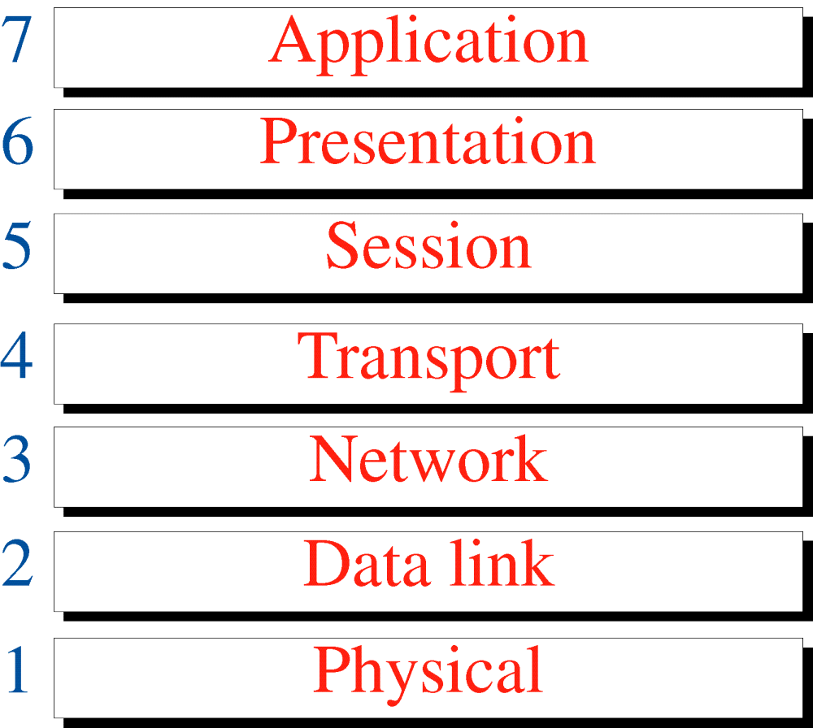
OSI Model

Slide 4
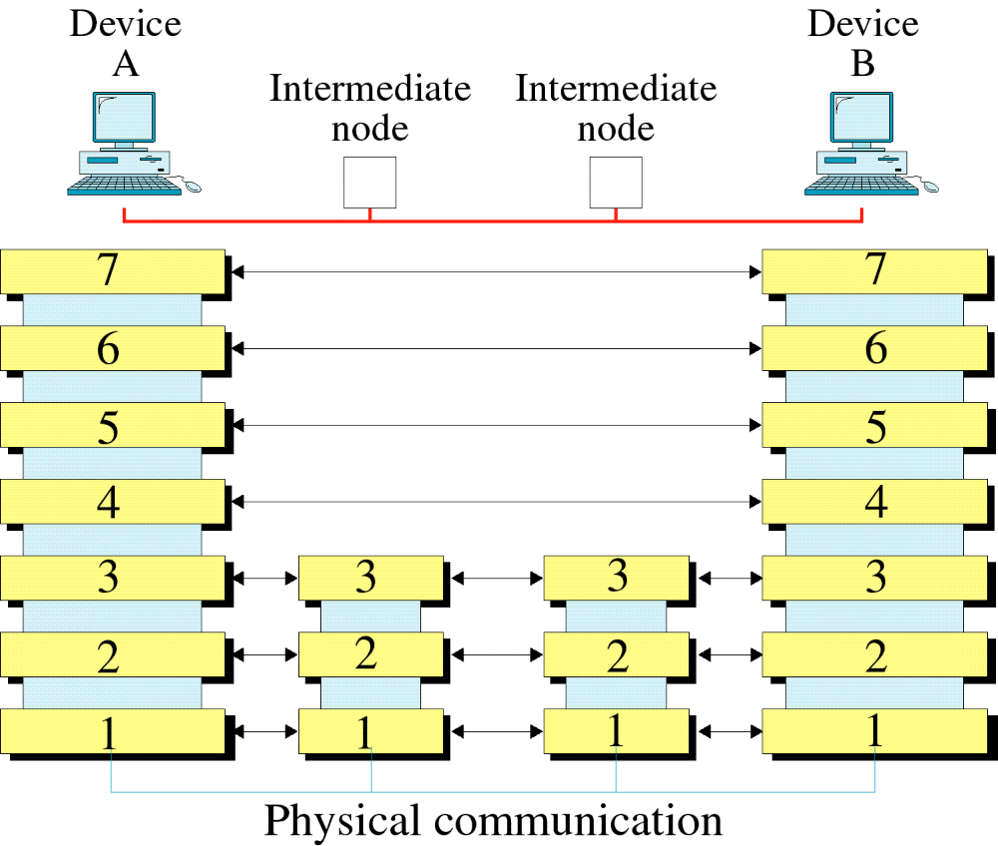
OSI Layers

Slide 5
Introduction
Open Systems Interconnection Basic Reference Model (OSI Reference Model or OSI Model) is an abstract description for layered communications and computer network protocol design.
It was developed as part of the Open Systems Interconnection (OSI) initiative. In its most basic form, it divides network architecture into seven layers which, from top to bottom, are the Application, Presentation, Session, Transport, Network, Data-Link, and Physical Layers.
It is therefore often referred to as the OSI Seven Layer Model.

Slide 6
OSI Model's 7 Layers
APPLICATION
Application to Application
APPLICATION
HIGHER LAYER
PRESENTATION
Application to Application
PRESENTATION
SESSION
Application to Application
SESSION
TRANSPORT
Process to Process
TRANSPORT
MIDDLE LAYER
NETWORK
Source to Destination
Router
NETWORK
Source to Destination
DATA LINK
Hop to Hop
Switch
DATA LINK
LOWER LAYER
Hop to Hop
PHYSICAL
Hub and Repeater
PHYSICAL
Physical Medium

Slide 7
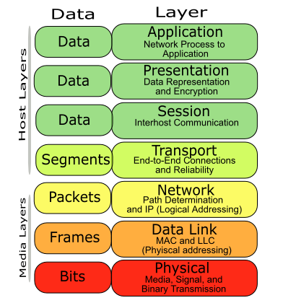
Host and Media Layer

Slide 8
These terms are used to refer at which OSI layer we are referring to, the data remain same but the headers and trailers are getting added or removed.
In Phy layer i.e. physical layer the actual data is in "bits" i.e. 0 and 1.
When it reaches to data link layer or Layer 2 it becomes "frame" with source and destination mac address getting added.
When it reaches the third layer or the networking layer it becomes a "packet" with source and destination IP address attached to it.
Finally it become "segment" at Layer 4 or TCP/IP layer. Basically "segment" term is used for TCP(Transmission Control Protocol) connections and "datagrams" for UDP(User Datagram Protocol).
So what about other layers like : session, presentation and application ? In these layers the data is termed as "PDU" or "protocol data unit".
So when someone says, that a "frame" is being received by a networking device, then you know that the device is switch.

Slide 9
Application Layer (user level service)
USER
(Human or Program)
USER
(Human or Program)
X.500
FTAM
X.400
X.500
FTAM
X.400
Application layer
Application layer
H7
Data
Message
H7
Data
Message
To presentation layer
From presentation layer
The application layer is responsible for providing services to the user.
Concerned:
  Network virtual terminal (Software)
  File transfer, access and management
  Mail services
  Directory services (access to distributed database sources for global information about various objects and services)

Slide 10
Presentation Layer (dependency)
From application layer
To application layer
presentation layer
H6
Data
H6
Data
presentation layer
To session layer
From session layer
The presentation layer is responsible for translation, compression and encryption(syntax or format, semantics
Concerned:
  Translation (interoperability between different encoding system)
  Encryption (Privacy schemes)
  Compression (data compression)

Slide 11
Encryption and decryption of a message for security
Compression and expansion of a message so that it travels efficiently
Graphics formatting
Content translation
System-specific translation

Slide 12
Session Layer (Dialog initiation)
From Presentation layer
To Presentation layer
Session layer
H5
Data
Data
Data
H5
Data
Data
Data
Session layer
Syn
Syn
Syn
Syn
Syn
Syn
To transport layer
From transport layer
The session layer is responsible for dialog control and synchronization
Concerned:
  Dialog Control (Half Duplex/Full duplex)
  Synchronization (Synchronization points, process inline within same page)

Slide 13
Transport Layer (Process to Process)
From session layer
From session layer
Segments
Segments
H4
Data
H4
Data
H4
Data
H4
Data
H4
Data
H4
Data
Transport layer
Transport layer
To network layer
From network layer
The transport layer is responsible for the delivery of a message from one process to another
Concerned:
  Service-point addressing (Port address)
  Segmentation and reassembly (Sequence number)
  Connection control (Connectionless or connection oriented)
  Flow control (end to end)
  Error Control (Process to Process)

Slide 14
• Application identification
• Client-side entity identification
• Confirmation that the entire message arrived intact
• Segmentation of data for network transport
• Control of data flow to prevent memory overruns
• Establishment and maintenance of both ends of virtual circuits
• Transmission-error detection
• Realignment of segmented data in the correct order on the receiving side
• Multiplexing or sharing of multiple sessions over a single physical link

Slide 15
Network Layer (Source to Destination)
From transport layer
To transport layer
Network layer
H3
Data
Packet
H3
Data
Packet
Network layer
To data link layer
From data link layer
The network layer is responsible for the delivery of individual packets from the source host to the destination host.
Concerned:
  Logical addressing (IP Address)
  Routing (Source to destination transmission between networks)

Slide 16
Virtual connection between application entities
Synchronization of data flow
Creation of dialog units
Connection parameter negotiations
Partitioning of services into functional groups
Acknowledgements of data received during a session
Retransmission of data if it is not received by a device

Slide 17
Data Link Layer (Host to Host)
From network layer
To network layer
Data link layer
H2
Data
T2
H2
Data
T2
Data link layer
To physical layer
From physical layer
Data link layer is responsible for moving frames from one hop (Node) to the next.
Concerned:
  Framing (stream of bits into manageable data units)
  Physical addressing (MAC Address)
  Flow Control (mechanism for overwhelming the receiver)
  Error Control (trailer, retransmission)
  Access Control (defining master device in the same link)

Slide 18
Layer 2 of the OSI model provides the following functions:
Allows a device to access the network to send and receive messages
Offers a physical address so a device’s data can be sent on the network
Works with a device’s networking software when sending and receiving messages
Provides error-detection capability
Common networking components that function at layer 2 include:
• Network interface cards
• Ethernet and Token Ring switches
• Bridges

Slide 19

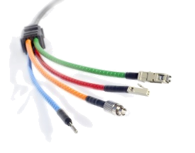
Physical Layer
From data link layer
To data link layer
Physical layer
110
10101000000010111
110
10101000000010111
Physical layer
Transmission medium
One of the major function of the physical layer is to move data in the form of electromagnetic signals across a transmission medium.
Its responsible for movements of individual bits from one hop (Node) to next.
Both data and the signals can be either analog or digital.
Transmission media work by conducting energy along a physical path which can be wired or wireless
Concerned:
  Physical characteristics of interface and medium (Transmission medium)
  Representation of bits (stream of bits (0s or 1s) with no interpretation and encoded into signals)
  Data rate (duration of a bit, which is how long it last)
  Synchronization of bits (sender and receivers clock must be synchronized)
  Line configuration (Point-to-Point, Point-to-Multipoint)
  Physical topology
  Transmission mode (Simplex, half duplex, full duplex)

Slide 20
Components of the physical layer include:
• Cabling system components
• Adapters that connect media to physical interfaces
• Connector design and pin assignments
• Hub, repeater, and patch panel specifications
• Wireless system components
• Parallel SCSI (Small Computer System Interface)
• Network Interface Card (NIC)

Slide 21
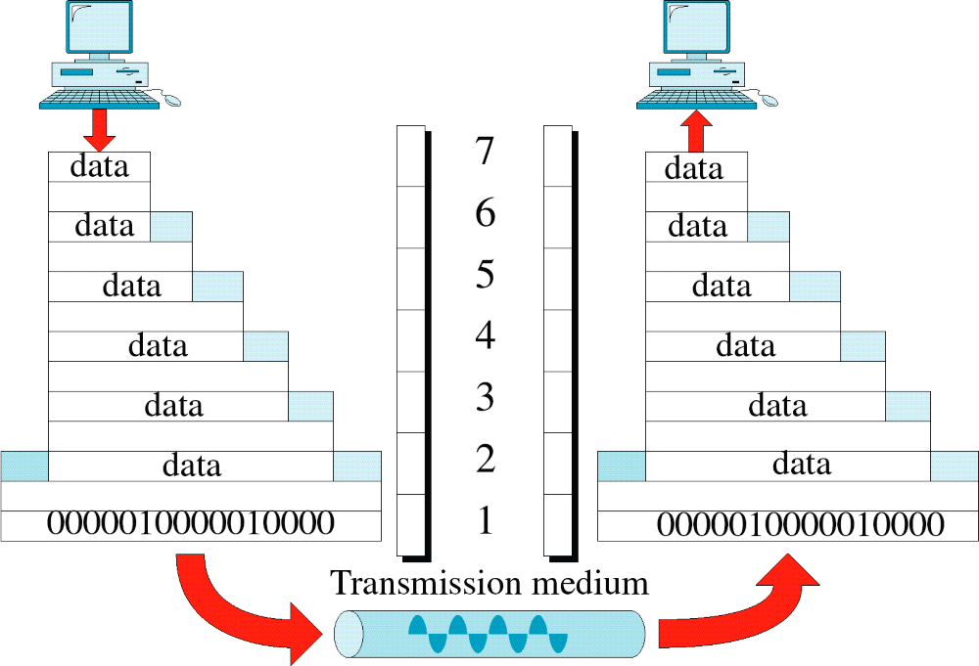
An Exchange Using the OSI Model

Slide 22
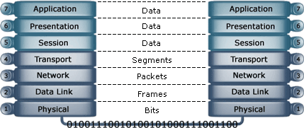

Slide 23
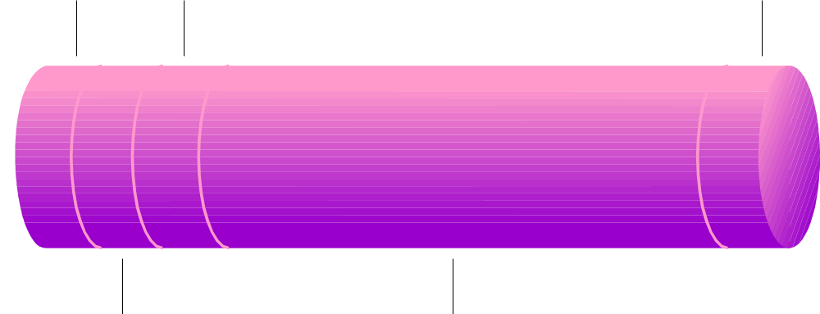
A simple data packet
Destination ID
Control
CRC
Sender ID
Data
Trailer
Header

Slide 24
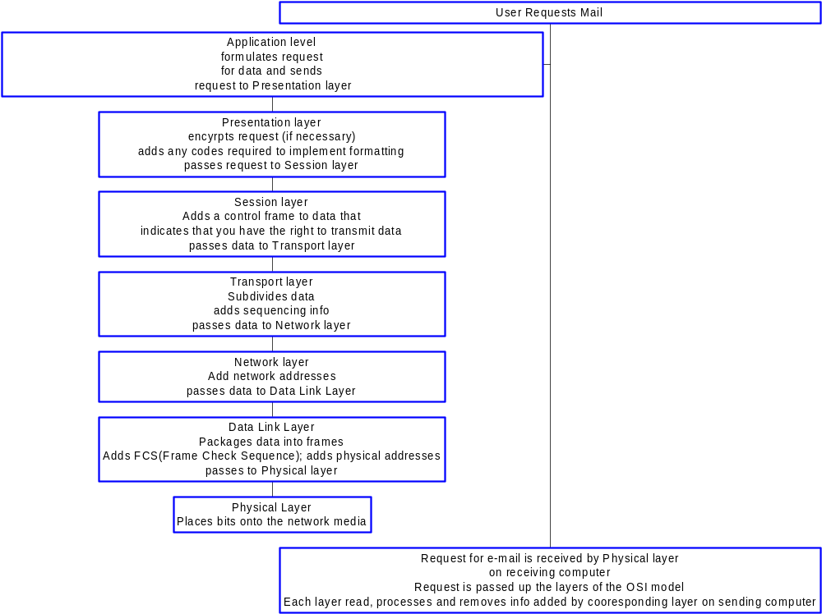
OSI Process

Slide 25
2.3 TCP/IP Protocol Suite
The TCP/IP protocol suite is made of five layers: physical, data link, network, transport, and application. The first four layers provide physical standards, network interface, internetworking, and transport functions that correspond to the first four layers of the OSI model. The three topmost layers in the OSI model, however, are represented in TCP/IP by a single layer called the application layer.
The topics discussed in this section include:
Physical and Data Link Layers
Network Layer
Transport Layer
Application Layer

Slide 26
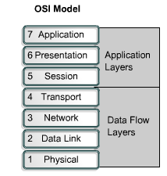
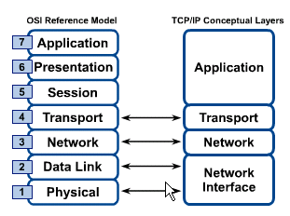
OSI & TCP/IP Models
TCP/IP Model

Slide 27
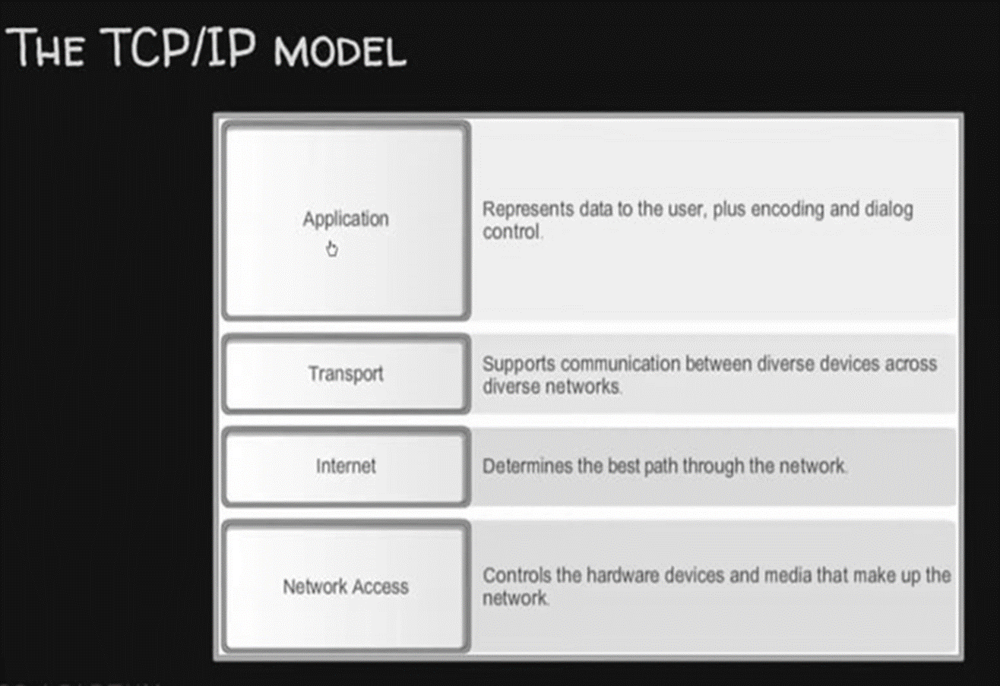

Slide 28
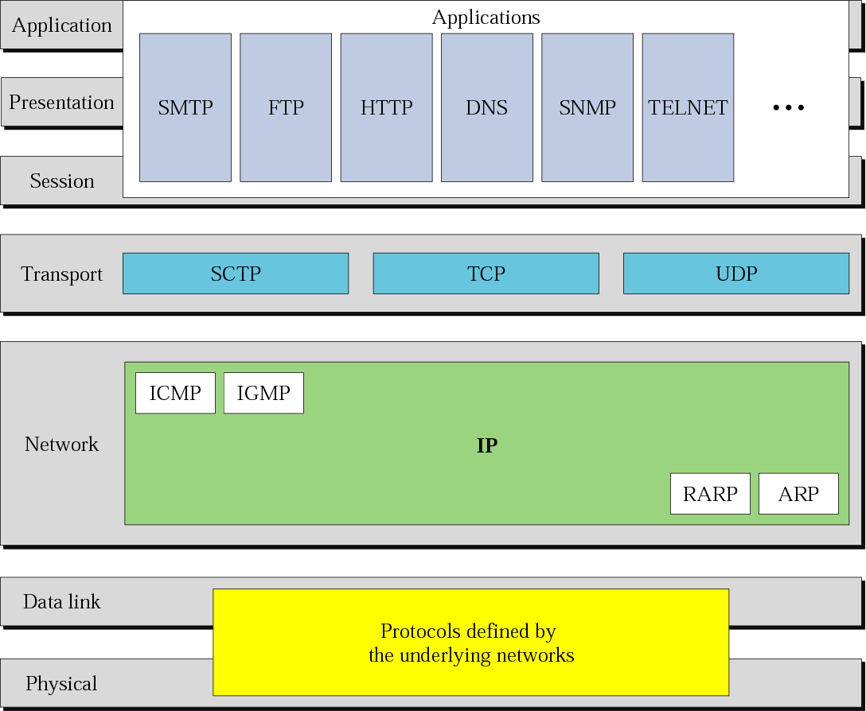
Figure 2.15 TCP/IP and OSI model

Slide 29
TCP/IP | OSI
Implementation of OSI model | Reference model
Model around which Internet is developed | This is a theoretical model
Has only 4 layers | Has 7 layers
Considered more reliable | Considered a reference tool
Protocols are not strictly defined | Stricter boundaries for the protocols
Horizontal approach | Vertical approach
Combines the session and presentation layer in the application layer | Has separate session and presentation layer
Protocols were developed first and then the model was developed | Model was developed before the development of protocols
Supports only connectionless communication in the network layer | Supports connectionless and connection-oriented communication in the network layer
Protocol dependent standard | Protocol independent standard

Slide 30
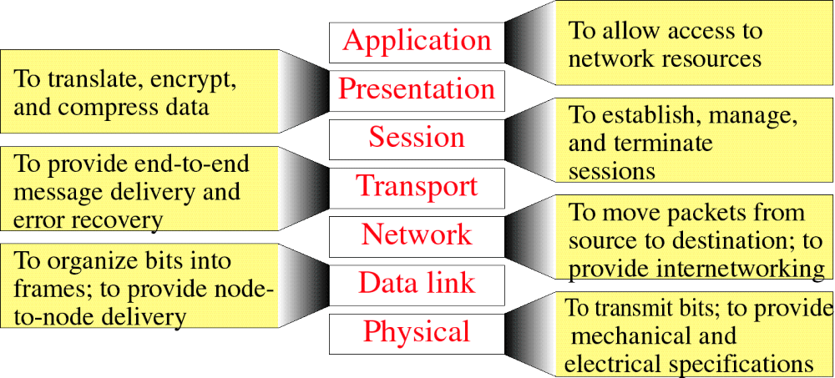
Figure 3-14
Summary of Layer Functions

